Slide 1
SURVEILLIANCE ROBOT
PRATHIK N NAZNEEN NEENKIRESUR SUHAS R

Slide 2
Objective
Robot(Controlled automatically)
Server based control system
Reliable surveillance
Neural network based locomotion
Image processing

Slide 3
Issues
Image processing efficiency
locomotion depends on environment
Finding compatible interface to computer for transmitters and receivers

Slide 4
Approach
Design of a neural network based on the environment
Design a perfect body for the robot based on environment
Create a interface between server and robot
Image processing

Slide 5
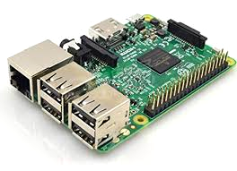
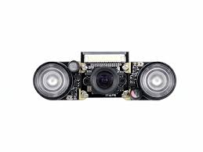
Major Components Needed
Raspberry Pi 3 Model B.
Infrared Video Recorder

Slide 6
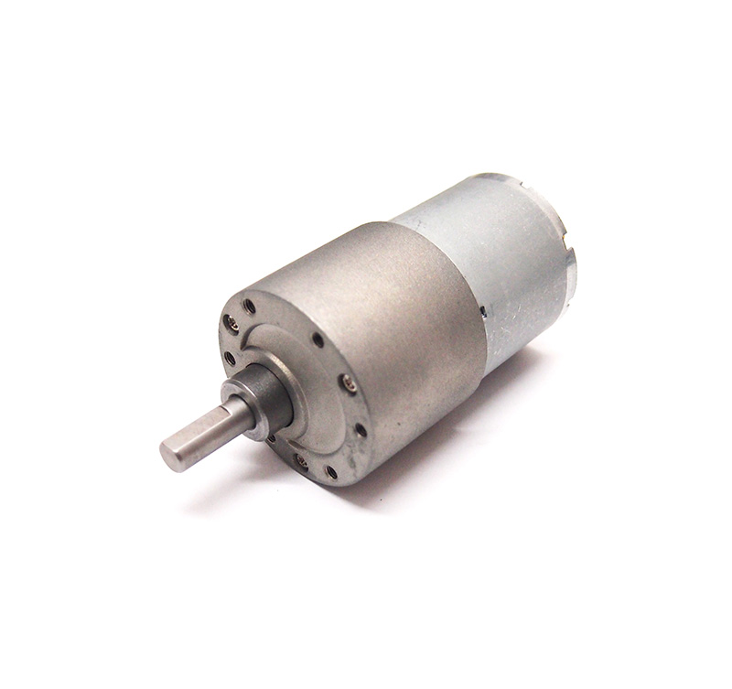
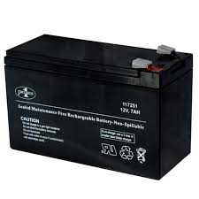
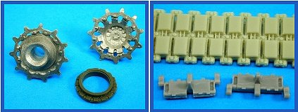
Major Components Needed
DC Motors
Batteries
Tracks and Wheels

Slide 7
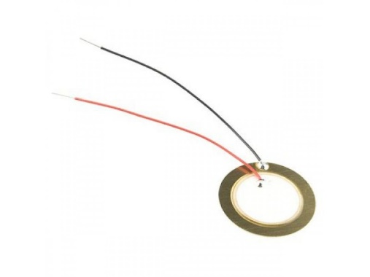
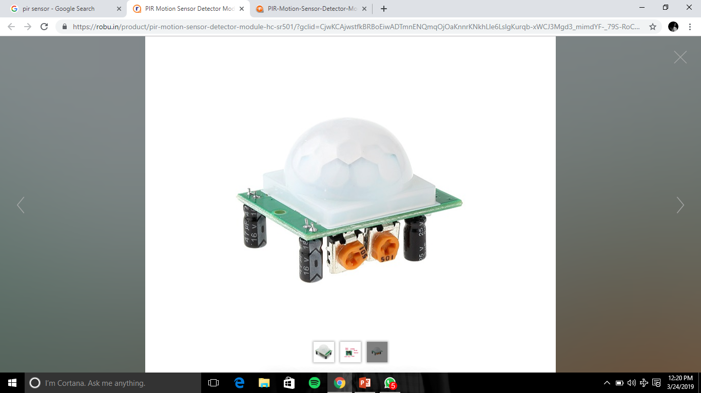
Major Components Needed
Piezoelectric
PIR Motion Sensor Detector

Slide 8
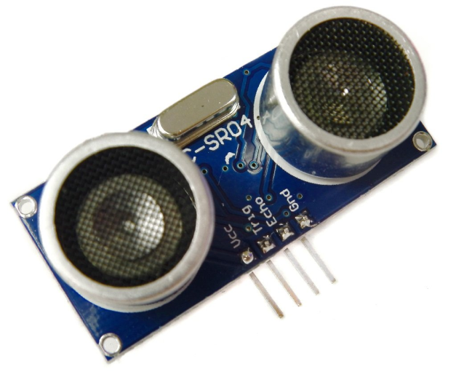
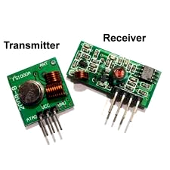
Major Components Needed
Ultrasonic/Sonar Distance Measuring Sensor Module
Transmitter and receiver module

Slide 9
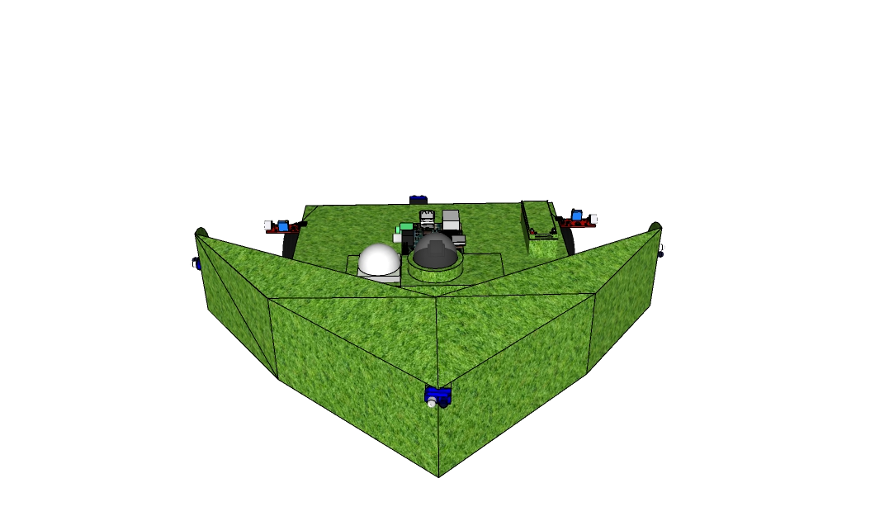
MODEL

Slide 10
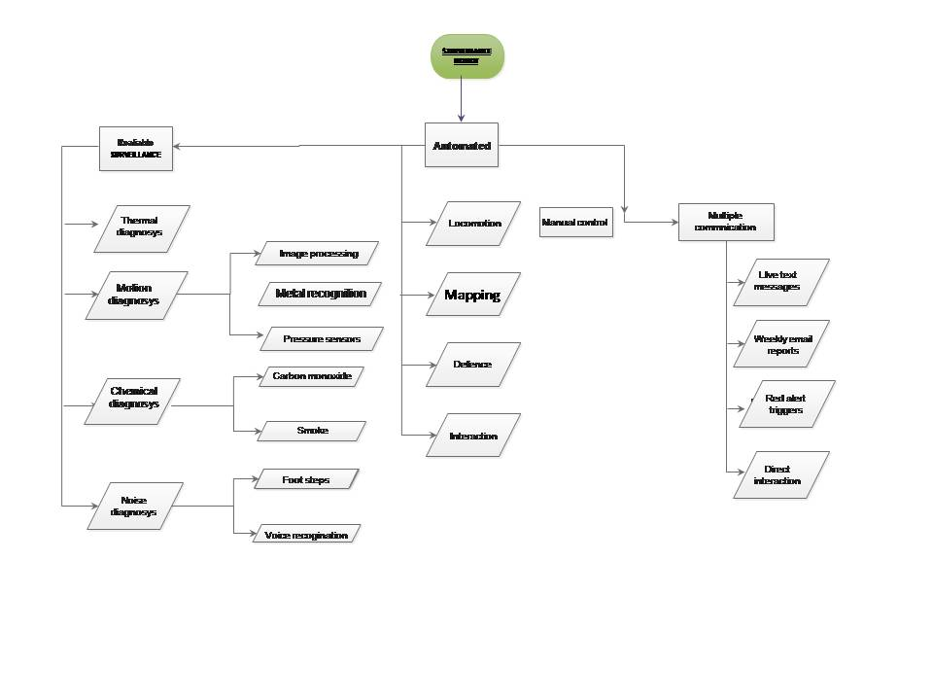
Block Diagram

